Slide 1
Cisco Programmability BlackBelt Bot – API Quick Reference Usage
Joel Jose (joeljos@cisco.com)
APJC Programmability Partner Systems Engineer
Date : 03 April 2019

Slide 2
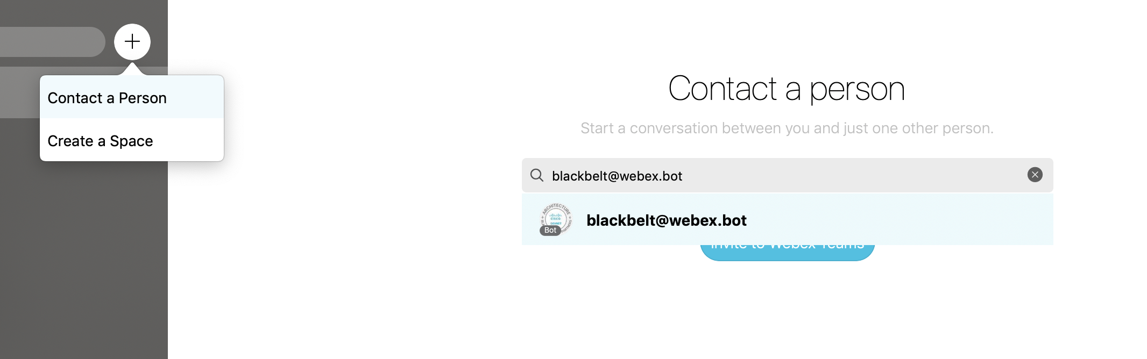
Step 1- Accessing the BlackBelt bot
a) Click on the + icon to the left pane of the Webex Teams and select “Contact a Person”
b) On the right pane – type blackbelt@webex.bot as the person to contact to and press enter

Slide 3
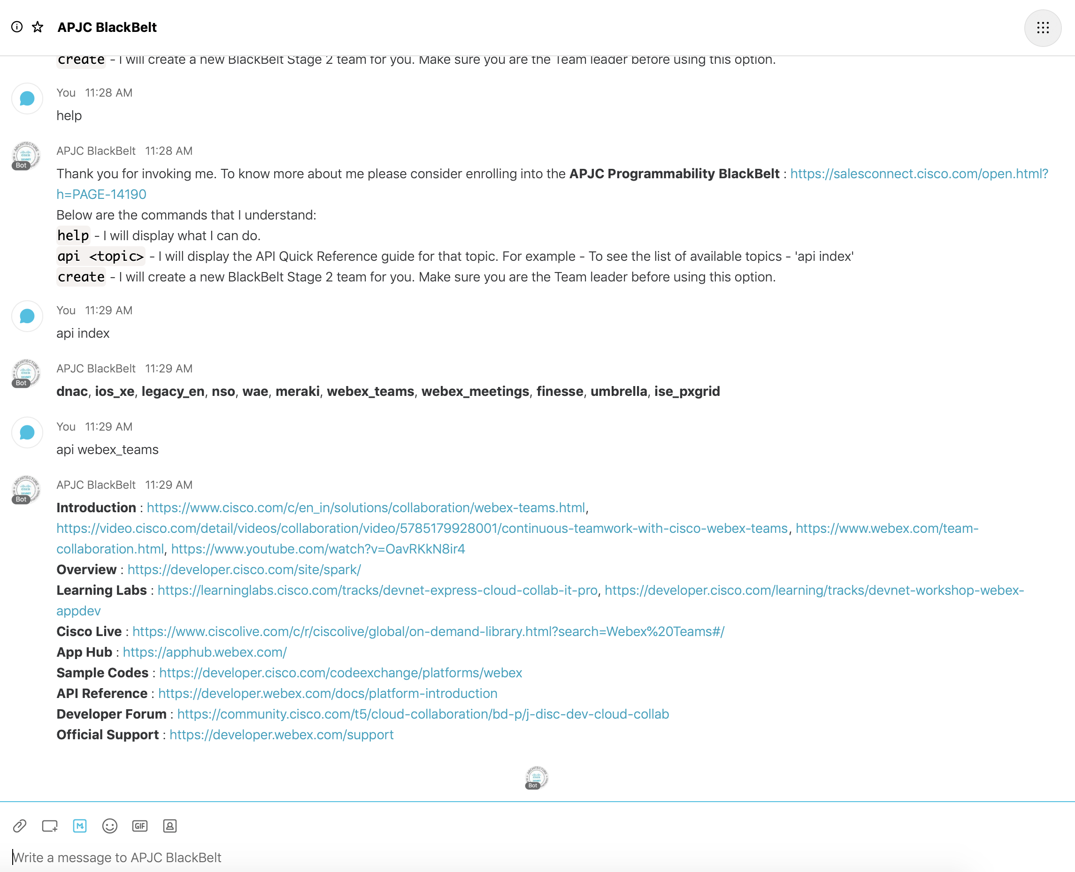
Step 2- Interacting with the BlackBelt bot
a) Inside the BlackBelt bot space, on the right pane – type “help” for list of commands that the bot understands
b) Type “api index” to see the list of available api quick reference topics
c) As an example, you may type “api webex_teams” to view the api quick reference for Webex Teams

